Slide 1

Locked-in Syndrome: changing information changing technology …changing ethics?
Andrew J. Haig, M.D.
President, the International Rehabilitation Forum Professor Emeritus, the University of Michigan

Slide 2
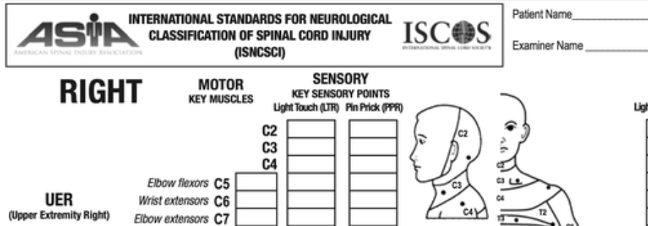
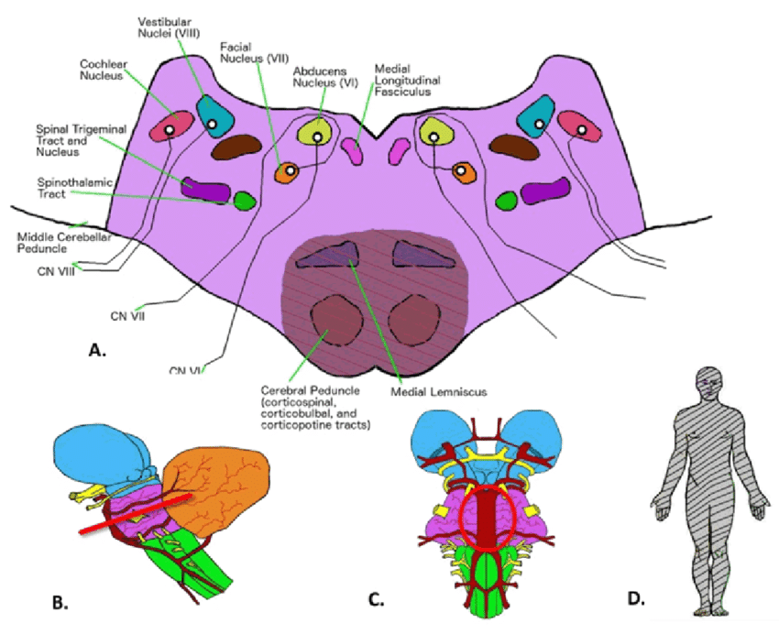

ASIA level: CN2-B?
CN 3-12 | 0/5 | intact | intact
CN II | partial | intact | intact
Complete LIS: EEG suggests consciousness.
Classical LIS: sensation fully intact, only able to move eyes up and down.
Functional LIS: sensation fully intact, can move but not manipulate objects.
Cuoco, Joshua & Hitscherich, Kyle & Hoehmann, Christopher. (2016). Brainstem Vascular Syndromes: A Practical Guide for Medical Students. Edorium Journal of Neurology. 3. 4-16. 10.5348/N06-2016-8-RA-2.

Slide 3
Scenarios:
A 45 year old man arrives in the emergency department after a motor vehicle accident. He can feel everything but can only move his eyes. His vital signs are dropping. No family around.
Do you resuscitate?
One day you feel dizzy and nauseous. Next thing you know you can’t move a thing but your eyes. The neurologist asks: do you want to be resuscitated?
Your eyes up? Or down?

Slide 4
Think about these:
What are the chances that a person with locked-in syndrome recovers?
Do people locked-in for more than 1 year wish they were dead?
What do acute trauma/neurology clinicians think?
What influences those decisions?
What influences have changed?

Slide 5

The first citation in the (wrong) literature:
The Count of Monte Cristo
By
Alexander Dumas
1846
Monsieur Noirtier had apoplexy (a stroke) but communicated with his daughter, using eyes up and down.
(The literary world felt this was just a creative parallel to the protagonist locked in jail.)

Slide 6
My very first scientific publication:
In 1986, as a house officer, I cared for a young lawyer with LIS
So I wondered…What is this thing?
I reviewed the world literature, 140 cases.
Almost all were reported dead*.
Only 2 were described as surviving more than a year
*In the 1980’s autopsy slides increased chance of publication as there were no MRI’s.
This bias towards mortality for LIS permeated the neurology/neurosurgery community.

Slide 7
I found 27 patients who remained locked in for more than a year. At one hospital
24/27 still alive when I found them
Mean survival so far 4.9 years. One for 12.5 years
Minimal recovery
17 lived with family
G-tubes, trach tubes, bladder caths mostly out
5 years later:
81% survived
10 years later:
Five-, 10-, and 20-year survival were 83%, 83%, and 40%

Slide 8
A case of LIS (with a vagus palsy)
Rural Wisconsin man with classical locked-in syndrome after a road traffic accident
Rehabilitation:
Gastrostomy tube, residual volumes were high
Suctioning: no change in heart rate
So we used a suppository – stomach emptied!
Tried s.c. bethanechol amd caused pulmonary edema. Oops.
Established communication with a Wu board
Extubated (cri du chat involuntary sounds improve safety)
Got rid of the foley catheter. He could signal and hold urine
Fed small amounts of food (automatic chew/swallow)
Stopped routine suppository (he could stimulate and signal bowel movements)
Discharged to nursing facility.
Happy there, family happy, addicted to Star Trek reruns, socialized with staff
Passed away more than a year later from infection
His wife called me to do an autopsy (!), we proved vagus nerve palsy

Slide 9



A book changed EVERYTHING! Jean-Dominique Bauby

Slide 10
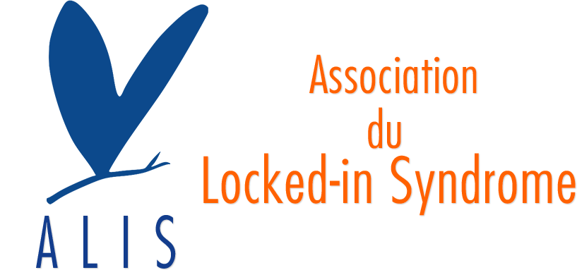
Funded by the profits of Baube’s book
At the 2003 ALIS conference I saw more presenters with LIS than were reported alive in my 1989 literature review

Slide 11
Technology changed
My first patient: eyes up means yes. I added a surface EMG electrode that buzzed, so he could do Morse code
Yeongchi Wu’s Wu Board
Eye tracking devices
EEG devices

Slide 12
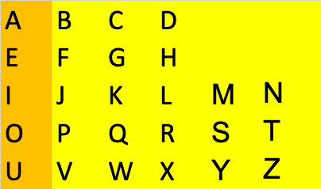
The Wu Board

Slide 13
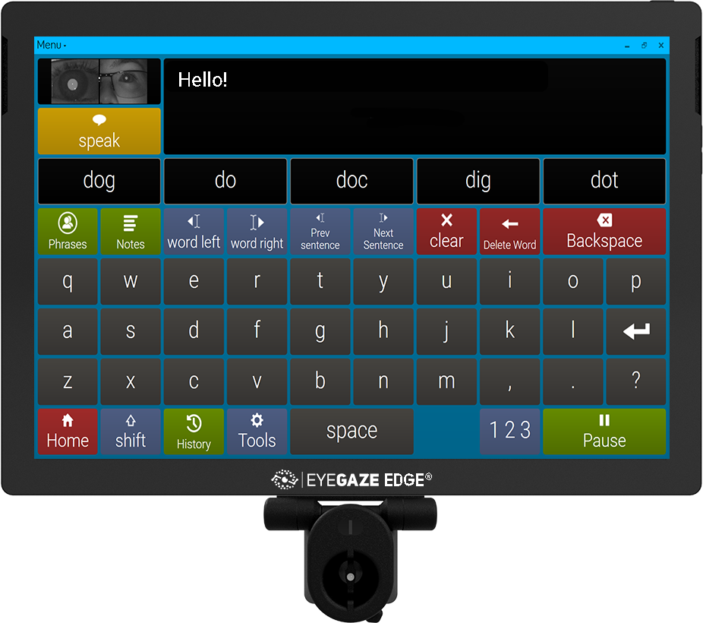
Eyegaze Edge®

Slide 14
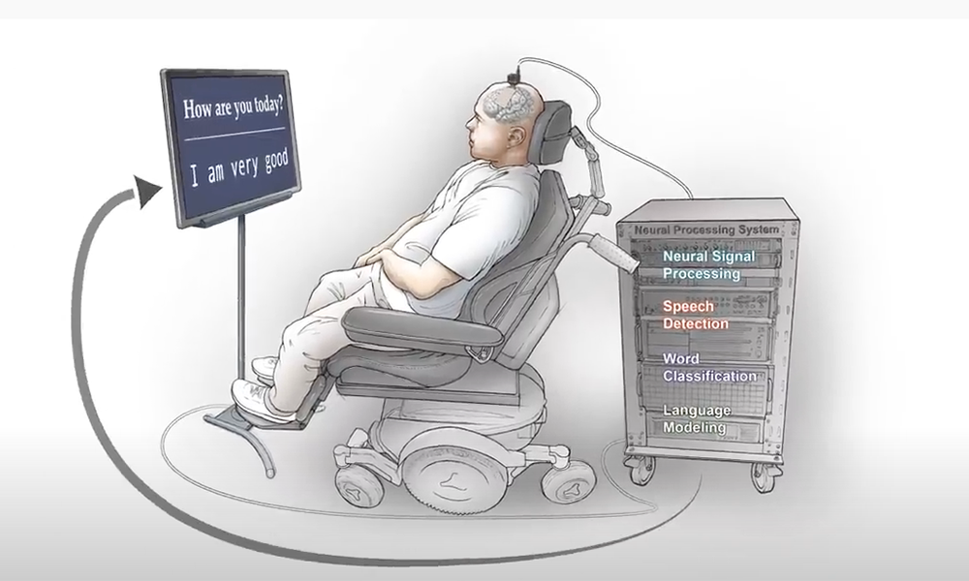
Nvidia /UCSF developer
Moses DA et al. Neuroprosthesis for Decoding Speech in a Paralyzed Person with Anarthria DOI: 10.1056/NEJMoa2027540

Slide 15
So now the challenge
Our perceptions?
Their perceptions?

Slide 16
Us: What are the chances that a person with locked-in syndrome recovers?
Actually pretty good within the first year--if they don’t die
After that, minimal change
Euthanasia?
Them: So, arragant @#@$ old doctor
What are the chances that the alcoholic you’re treating recovers from their hell?
Gonna knock them off, too?

Slide 17
Us: What percentage of people locked-in for more than 1 year wish they were dead?
Them: What percentage of dentists, social workers, performing artists and teenagers going through puberty wish they were dead?

Slide 18
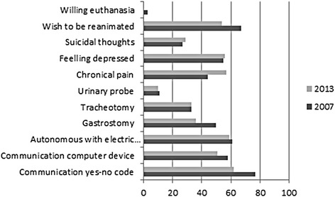
What do they say?
Our study: 7 satisfied with life, 5 sometimes depressed.
1 wished to die, 7 never considered it, 6 outright rejected
Graph from Rousseau 2015.
(see Schnetzer 2023 for a comprehensive recent review of LIS)

Slide 19
Us: What percentage of acute trauma/neurology clinicians think these people wish they were dead?
Back in 1987 “Conscious Hell” (Pearce)
Now? Probably still most. 42% of European clinicians wish to be dead if they have LIS. (Demertzi) 90% of German neurologists would choose limit life-saving measures (Kuehlmeyer)
Them: What percent of people with Locked-In Syndrome wished they had the horrible life of a trauma surgeon?
Locked-in to a room without windows, can’t itch their forehead, can’t see anyone smile, messy stinky work, never see your family…

Slide 20
What influences those decisions?
Knowledge
of early recovery
of long-term survival
of possibilities
of quality of life
Not necessarily technology
Our patients were studied before eye-gaze computers
But the new technology and internet accessibility help non-patients imagine their own quality of life with LIS
Publicity stunts
Baube, the physicist Steven Hawkings and others
Techno-gee-whiz stuff that grabs attention
OK, medical education efforts…

Slide 21
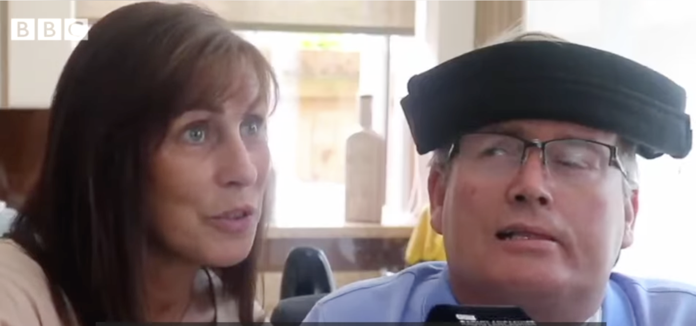
In 2010, former Premiership footballer Gary Parkinson had a massive stroke and was later diagnosed with locked-in syndrome.^{[16]} This, however, has not ended his career in football, as he is now part of Middlesbrough F.C.’s scouting analysis team, watching potential players on DVD and relaying the verdict to the Middlesbrough manager Tony Mowbray solely through blinking.
https://www.facebook.com/watch/?v=333670734449431
Source: Wikipedia

Slide 22

Martin Pistorius began developing locked-in syndrome when he was 12 years old. He went into a coma for two to three years, after which point he slowly regained consciousness but was unable to communicate this to others until he was around 19 years of age. Now capable of some movement and able to communicate with a speech synthesizer, Pistorius works as a freelance web designer/developer and has published a book about his life entitled Ghost Boy.
https://www.youtube.com/watch?v=nxgQw7YkAuQ
Source: Wikipedia

Slide 23

Nick Chisholm (born 1973 in Dunedin, New Zealand), the brother of Survivor NZ host Matt Chisholm, had a series of mini-strokes, culminating in a massive brainstem stroke during a rugby game at the age of 27 on 29 July 2000. He has since recovered some muscle usage, and has become a bodybuilder and a personal trainer for other disabled people. He cannot speak and communicates via pointedly moving his eyes around a clear plastic board with letters and number on it to spell out what he wants to say. On March 26, 2020, his wife Nicola gave birth to triplets, conceived with Nick via IVF.
https://www.facebook.com/reel/1070103257387148
Source: Wikipedia

Slide 24
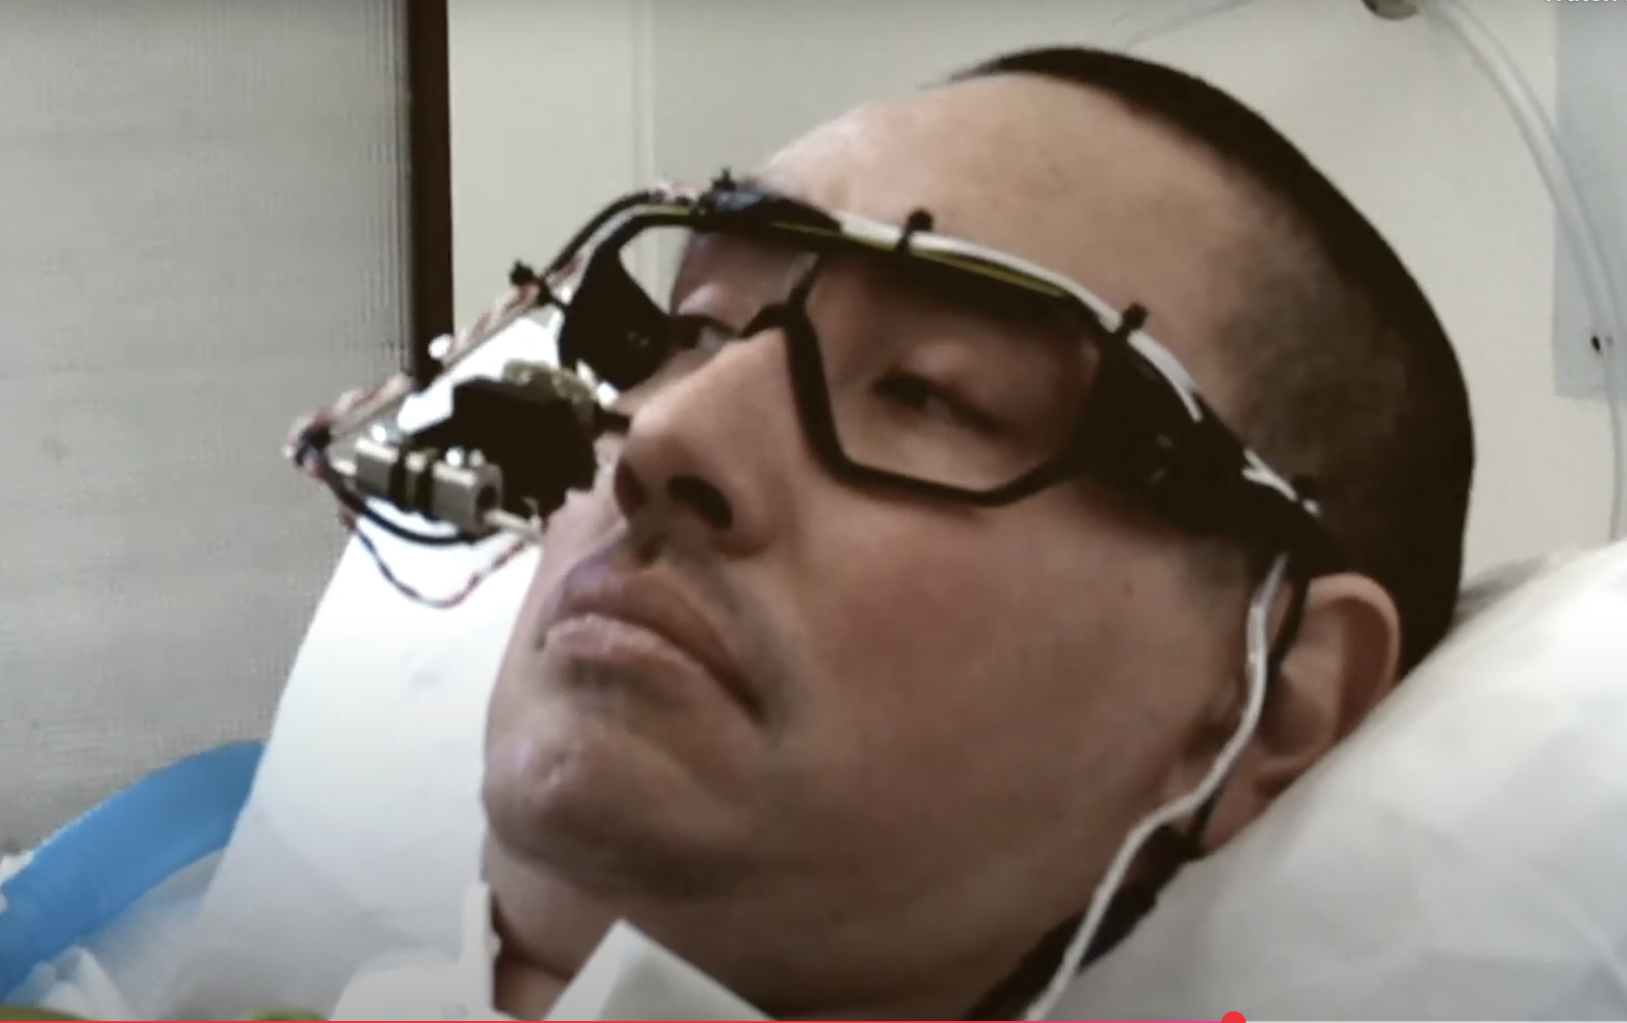
Tony Quan, a graffiti artist, was diagnosed with the nerve disorder ALS in 2003, which eventually left him fully paralyzed except for his eyes. Quan used the EyeWriter technology to communicate his art and has since had his work displayed in numerous art shows nationally
https://www.notimpossible.com/projects/tempt-and-the-eye-writer
Source: Wikipedia

Slide 25
Some pertinent references:
Haig AJ, Katz RT, Sahgal V: Locked‑in syndrome: A review of the literature. Current Concepts Rehabil Med 3:12-16, 1989.
Doble JE, Haig AJ, Anderson C, Katz R. Impairment, activity, participation, life satisfaction, and survival in persons with locked-in syndrome for over a decade: follow-up on a previously reported cohort. J Head Trauma Rehabil. 2003 Sep-Oct;18(5):435-44.
Katz RT, Haig AJ, Clark BB, DiPaola RJ. Long-term survival, prognosis, and life-care planning for 29 patients with chronic locked-in syndrome. Arch Phys Med Rehabil. 1992 May;73(5):403-8.
Haig AJ, Katz RT, Sahgal V. Mortality and complications of the locked-in syndrome. Arch Phys Med Rehabil. 1987 Jan;68(1):24-7.
Haig AJ, Ho K-C, Ludwig G: Clinical, physiologic, and pathologic evidence for vagus dysfunction in a case of traumatic brain injury. J Trauma 40(3):441-444, 1996.
Haig AJ: ‘I really got to know my patient in the morgue.’ Medical Economics 75(8)116-124, 1998.
Wu, Yeongchi et al. User-friendly communication board for nonverbal, severely physically disabled individuals Archives of Physical Medicine and Rehabilitation, Volume 66, Issue 12, 827 – 828, 1985
Rousseau MC, Baumstarck K, Alessandrini M, Blandin V, Billette de Villemeur T, Auquier P. Quality of life in patients with locked-in syndrome: Evolution over a 6-year period. Orphanet J Rare Dis. 2015 Jul 19;10:88.
Schnetzer L, McCoy M, Bergmann J, Kunz A, Leis S, Trinka E. Locked-in syndrome revisited. Therapeutic Advances in Neurological Disorders. 2023;16. doi:10.1177/17562864231160873
Pearce JM. The locked in syndrome. Br Med J 1987; 294: 198–199
Demertzi A, Jox RJ, Racine E, et al. A European survey on attitudes towards pain and end-of-life issues in locked-in syndrome. Brain Inj 2014; 28: 1209–1215
Kuehlmeyer K, Racine E, Palmour N, et al. Diagnostic and ethical challenges in disorders of consciousness and locked-in syndrome: a survey of German neurologists. J Neurol 2012; 259: 2076–2089

Slide 26
Thank you!
Mario Greyling and Nurture Health
Vee Wilson, Francois Theron and the IRF’s Physical Medicine and Rehabilitation Fellows from South Africa
ISCOS and South Africa!

